Slide 1
Portable Ladder Safety Sedgwick Risk Services Presented by Sedgwick on behalf of ORM March 2020

Slide 2
Disclaimer
The information contained herein is not intended as legal advice, is advisory only; provided on an “as is” basis, and to be used solely at the user’s risk. The information is made available without any warranty of any kind and, to the extent allowed by law, Sedgwick disclaims any and all implied warranties and representations. All procedures and training, whether required by law or not, should be implemented and reviewed by safety and risk management professionals and legal counsel to ensure that all local, state, and federal requirements are satisfied. Sedgwick disclaims any and all liability that may arise in connection with a user’s use of this information.

Slide 3
Course Outline – Portable Ladder Safety
Why Take Portable Ladder Safety Training?
Ladder Selection
Ladder Inspection
Proper Placement
Proper Use
Maintenance and Storage
Other Safety Measures
Summary

Slide 4
Why Take Portable Ladder Safety Training?
Ladders use, in particular ascending and descending ladders, is one of the leading causes of occupational fatalities.
Most ladder accidents are caused by improper selection, care or use, not by manufacturing defects.
Hazards involving ladders, such as instability, electrical shock, and falls, can be predicted and prevented.
Prevention requires proper planning, correct ladder selection, sound work procedures and excellent ladder maintenance.

Slide 5
Ladder Selection
Choosing the proper ladder:
Use ladders for their designed purpose. Read and follow all manufacturer instructions and warnings!
Portable ladders are those that can be easily moved or carried and include:
Fold-out or self-supporting ladders such as step ladders.
Leaning or non-self-supporting ladders such as straight or extension ladders.

Slide 6
Ladder Selection
Choosing the proper ladder (continued):
Read and follow all manufacturer instructions, and the markings and labels on the ladders.
Do not exceed the maximum load rating of any ladder.
In addition to the weight of the person, be sure to include the weight of any tools and equipment that will be used on the ladder when calculating the maximum load

Slide 7
Ladder Inspection
Before you begin:
All ladders must be inspected by a competent person prior to use and after any incidents, as well as when any damage is suspected.
Ladder steps must be parallel, uniformly spaced and free of debris or slippery material.
Ladders need to be inspected for rough edges, warping, breaks or broken joints, etc., to prevent snagging or potential scrape hazards. Follow the manufacturer inspection requirements.
Make sure the hooks and locks on the extension ladder are in good condition.
Replace worn or frayed ropes on extension ladders at once.

Slide 8
Ladder Inspection
Before you begin (continued):
Wood ladders cannot be painted or coated with any opaque covering other than manufacturer-provided warning labels.
Painting can disguise defects.
Warning labels must not be removed or altered in any way.

Slide 9
Ladder Inspection
Isolating unsafe equipment:
Any ladders with broken rungs, railings, signs of corrosion, loose rivets, fastenings or unsafe wear and tear must be removed from service.
Remove these portable ladders from the area and mark them with signage that indicates that they cannot be used until repaired.
Develop a checklist from the manufacturer owner’s manual to guide you with your inspection.

Slide 10
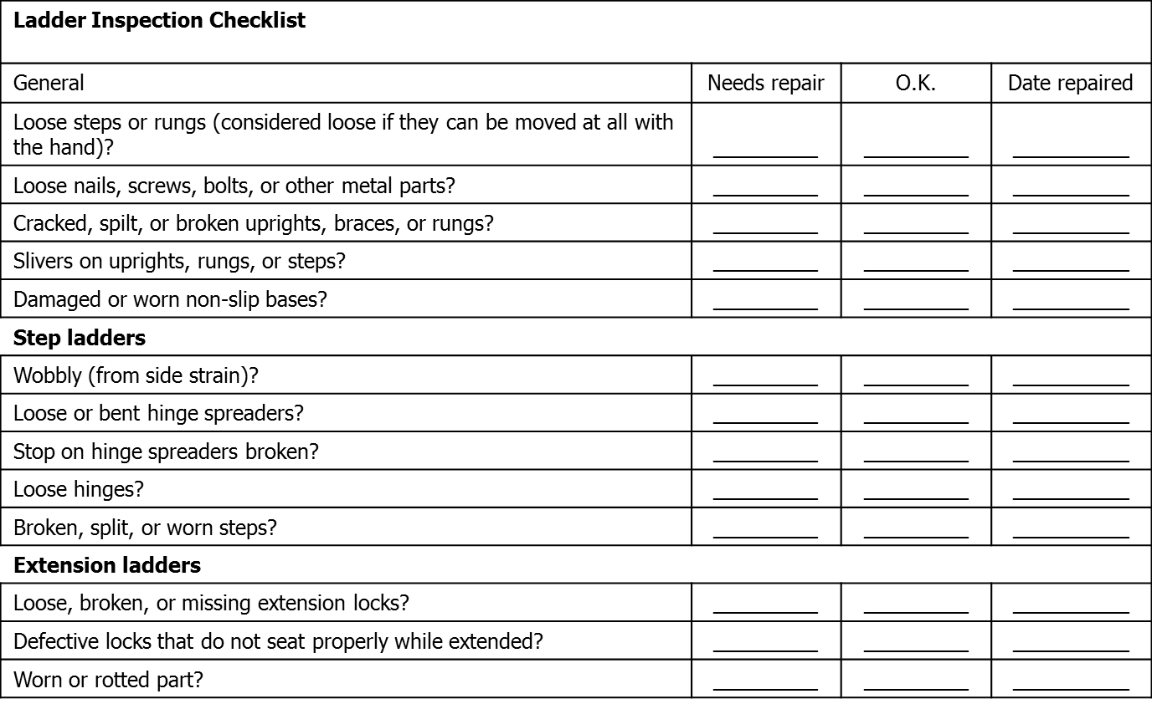
Ladder Inspection

Slide 11
Proper Placement
Ladder set up and placement:
Use only on stable and level surfaces.
If the work must be done on uneven terrain, on a slope or during adverse weather conditions:
Secure the ladder’s top and bottom.
Assure that the feet are slip-resistant.
Use a ladder wedge or other means to stabilize the feet of the ladder from slipping, sinking, or blowing over.
Avoid electrical hazards: Do not use a metal ladder near any energized electrical equipment.

Slide 12
Proper Placement
Ladder set up and placement (continued):
Do not tie two ladders together to make them longer.
If two ladders are needed to reach a height, separate them with a platform or landing between ladders.
Do not boost or make a ladder taller by placing it on boxes or other surfaces.
Do not use ladders as scaffolds.

Slide 13
Proper Placement
Be aware of your surrounding area:
Ladders must not be placed in front of doors that open toward the ladder unless the door is blocked open, locked, or guarded.
Mark and control all access ways to prevent exposure to other personnel in the area.
Keep the areas around the top and bottom of ladders clear of tools and debris.
Restrict the area to prevent injury to others.

Slide 14
Proper Placement
If the area is not secure:
Have someone hold the ladder or guard the base at all times.
Barricade off the section to prohibit any activity at the base.
Anchor non-self-supporting ladders at the base and top to fixed points to prevent the ladder from falling or moving. It is best practices to anchor these ladders even if the area is secure.

Slide 15
Proper Placement
Guidelines for extension ladders:
The proper angle for setup:
Place the base one-fourth the working length of the ladder away from the wall or vertical surface.
When the ladder is used to access an elevated area:
The side rails must extend at least 3 feet above the upper support.
Top rails must be level and equally supported on upper surface.
If this cannot be done, use a grab rail or grasping device to assist people in getting on and off the ladder.

Slide 16
Proper Use
Climbing or descending ladders:
Never lean out past the side rails of the ladder (beyond the sternum of your chest) to extend your reach.
Face the ladder when climbing up or down.
Only one person is to be on a ladder at a time.
Do not jump down off a ladder.

Slide 17
Proper Use
Use a three-point-contact system:
Keep hands free when ascending and descending the ladder to maintain a three-point-contact.
Do not carry loads.
Tools and other objects must be pulled up or lowered using a hand-line, or secured on a tool-belt.

Slide 18
Proper Use
Working on ladders:
Portable ladders are designed for temporary access only and not permitted as a permanent work surface.
Set scaffolding or use other suitable and safe work structures for extended work at elevated levels.
Do not put one foot on the ladder and the other on an adjacent surface or object.
Do not move or shift a ladder with a person on it.

Slide 19
Proper Use
Working on ladders (continued):
Always secure ladders at the top and bottom.
When working at higher levels always secure yourself to the ladder using a safety belt or positioning strap secured to the ladder.
Do not climb ladders when:
The weather is windy or stormy.
You are ill or tired.
You are taking medication that impairs alertness or coordination.

Slide 20
Proper Use
Guidelines for step ladders:
Never use a step ladder in a partially closed position.
Always make sure the cross spreaders are completely open.
Do not stand on the top two steps of the ladder.

Slide 21
Proper Use
Guidelines for step ladders (continued):
Do not climb on the rear of a step ladder unless the ladder is designed to be used on both sides.
Do not climb on any cross bracing.
Step ladders must not exceed 20 feet in length.

Slide 22
Proper Use
Guidelines for extension ladders:
Do not stand on the top three rungs of the ladder.
Rungs must be grooved, corrugated or coated with a slip-resistant material.
The suggested length for a single ladder, or single section of a ladder, is not more than 30 feet.
Two-section ladders must not surpass 48 feet.
Any ladder longer than two sections must not be more than 60 feet in length.

Slide 23
Proper Use
Guidelines for extension ladders (cont.):
Extension ladders must be equipped with stops to ensure the proper overlap.
Based on the length of the ladder, each section has a specific, defined overlap:
For ladders up to and including 36 feet, the overlap must be at least 3 feet.
For over 36 feet to 48 feet, the overlap must be at least 4 feet.
For over 48 feet to 60 feet, the overlap must be at least 5 feet.
Ensure that all section locks are securely engaged.

Slide 24
Proper Use
Use proper Personal Protective Equipment (PPE):
Follow your JSA, which will be based on tasks, associated hazards, and the specified PPE.
Choose footwear with good support and non-slip soles.
Use safety glasses for overhead work.
Ladders are not permitted for extended work at elevations. Use a work platform or another appropriate approach, and follow your Fall Protection Program.

Slide 25
Maintenance and Storage
Ladder repair:
Ladders must be repaired and restored to their original condition before being brought back into service.
Ladders that cannot be properly restored must be discarded.
Keep the metal bearings of locks, wheels, pulleys, etc., lubricated as part of your preventive maintenance plan.

Slide 26
Maintenance and Storage
Ladder maintenance:
Wood ladders can be protected with a clear sealer varnish, shellac, linseed oil or wood preservative.
Check carefully for cracks, rot, splinters, broken rungs, loose joints or bolts and hardware in poor condition.
Fiberglass ladders have a surface coat of lacquer that needs to be maintained.
If it is scratched beyond normal wear, lightly sand before applying a new coat of lacquer.

Slide 27
Maintenance and Storage
Transporting and storing ladders:
Because ladders are unwieldy, moving them presents certain challenges. Use caution.
Lift with your legs, not your back. Get help as needed! Clear the path of travel and set destination points prior to lifting the ladder.
Including an individual trained in ladder movement on the work team will simplify and expedite ladder moving.

Slide 28
Maintenance and Storage
Transporting and storing ladders (Cont.):
When storing ladders vertically, hang them near the top rung.
Store ladders where they are protected from damage.
For horizontal storage, provide hooks every 6 feet and near both ends to prevent bowing.

Slide 29
Other Safety Measures
Have an emergency plan in place:
Have an appropriate emergency response plan. Include:
How to call 911.
How to respond to a potential neck or spinal injury.
Apply best practice methodology and have supervisors and workers trained in first aid and cardiopulmonary resuscitation (CPR).
Issue portable communication devices to field crews for use in an emergency.

Slide 30
Other Safety Measures
Practice safety:
Maintain all ladders in good condition.
Perform preventative maintenance in the off-season.
Clean dust and debris from steps or platforms.
Be sure that steps leading to the equipment are free of mud, ice, and snow build-up.
Keep the entrances to buildings clear.
Encourage workers to wear shoes with a solid, slip-resistant tread.
Good traction reduces the chance of slipping and falling.

Slide 31
Summary – Portable Ladder Safety
Ladder safety begins with the selection of the appropriate ladder.
There are different types of ladders for different purposes.
Be sure your ladder is properly positioned.
Proper behavior can reduce falls and accidents.
Regular inspections are crucial for ladder safety.

Slide 32
Thank you | questions

